Slide 1
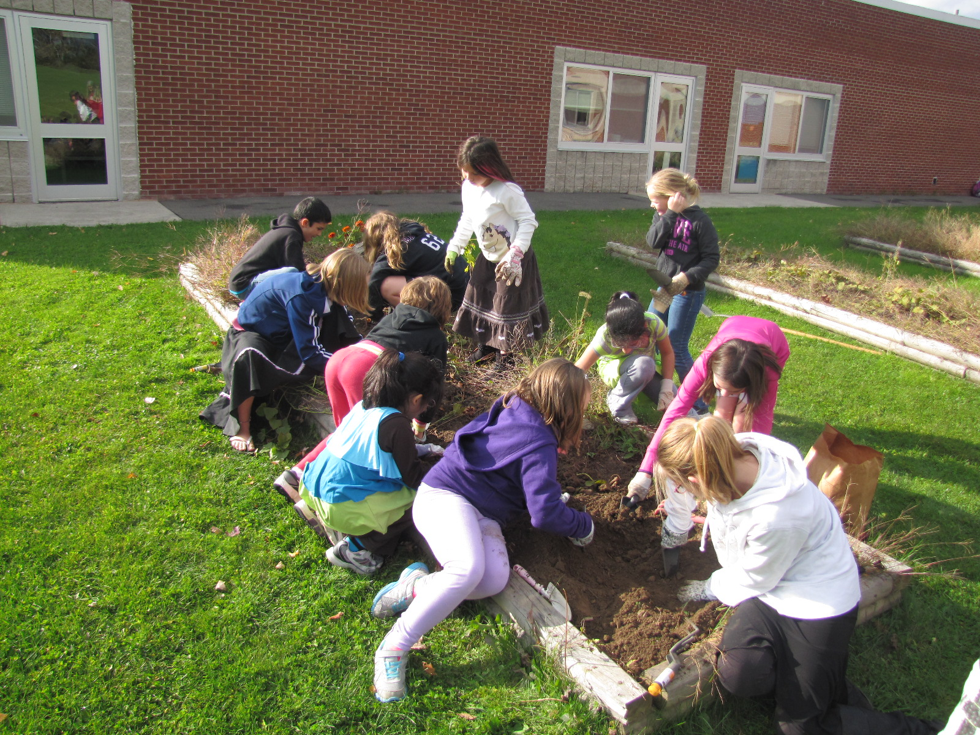
Green Thumb Growers Guild
@Sidney Elementary School

Slide 2
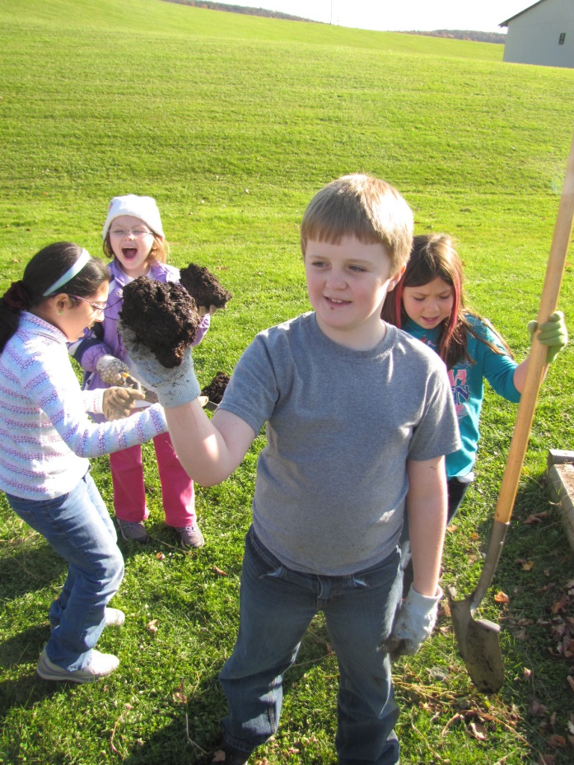
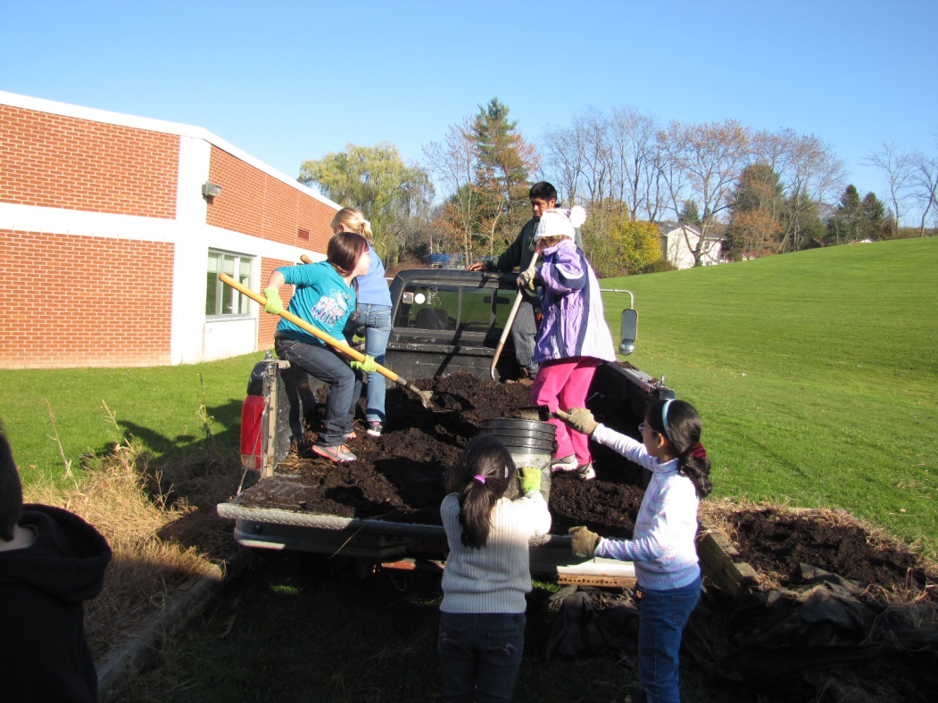
Outdoor Garden

Slide 3
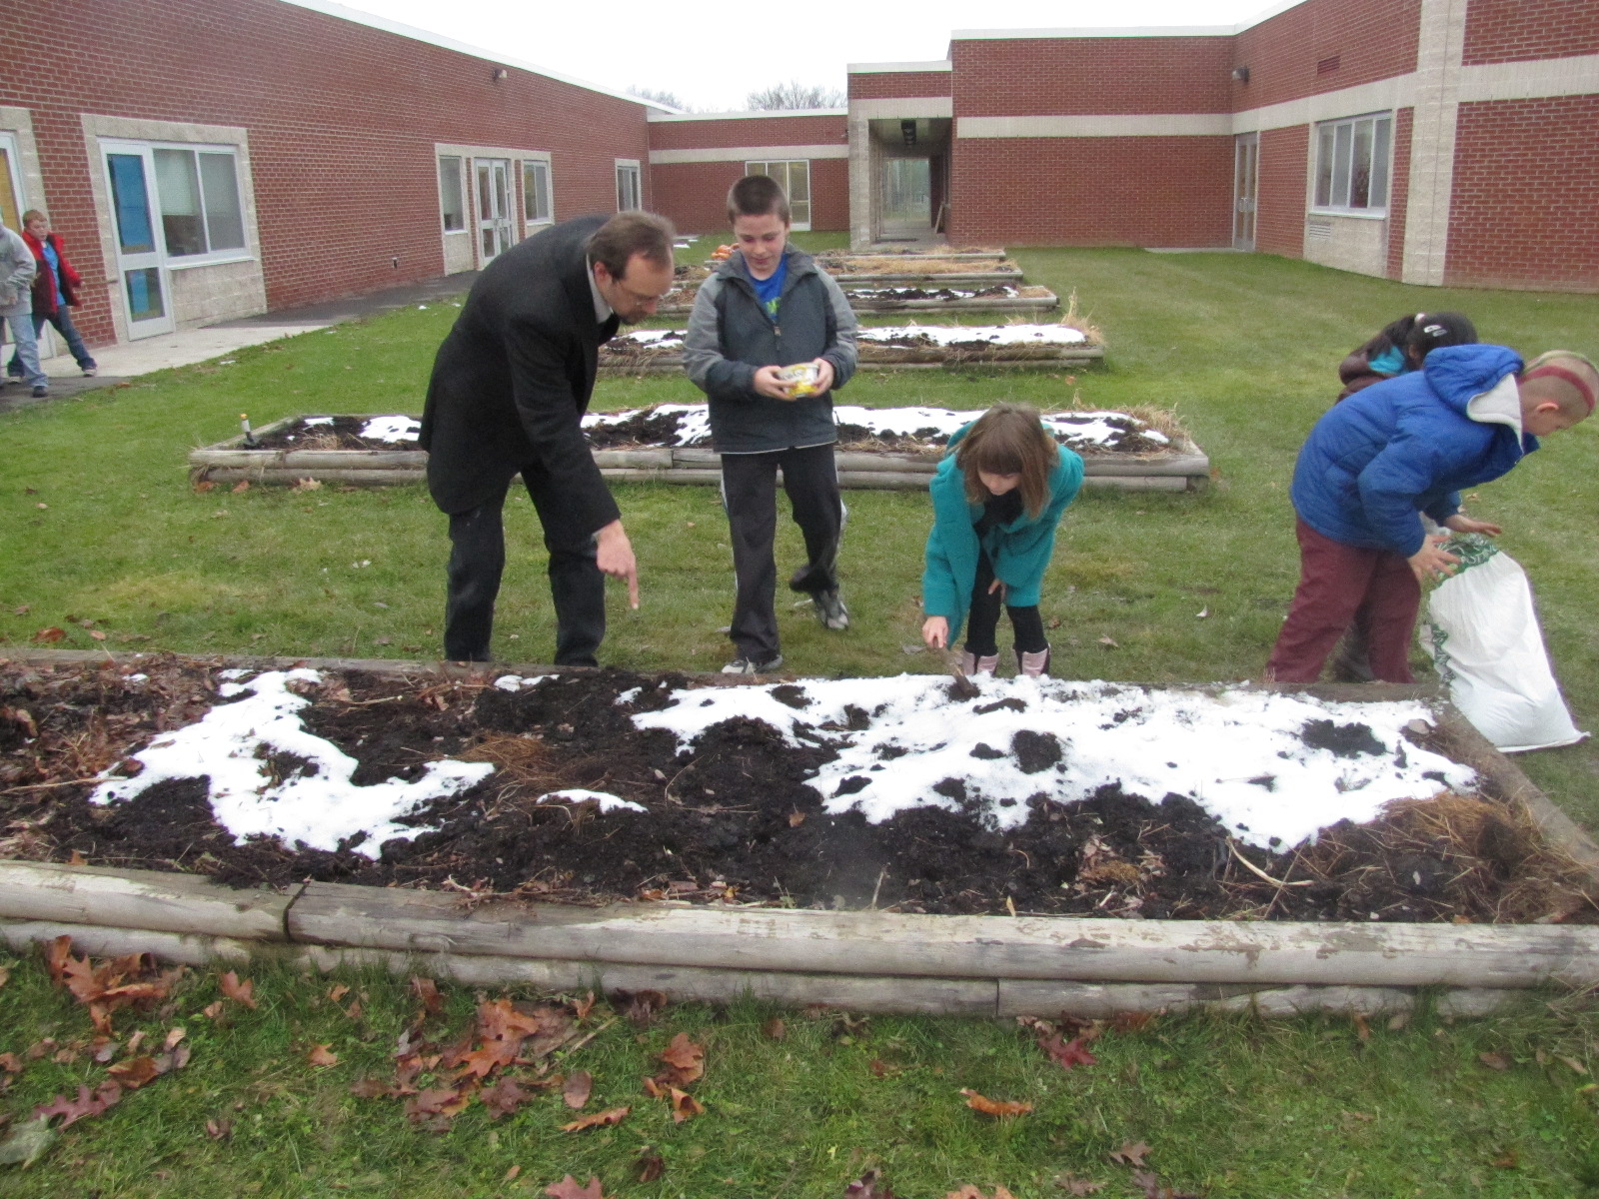
Outdoor Garden
Planting Garlic, December 2013

Slide 4
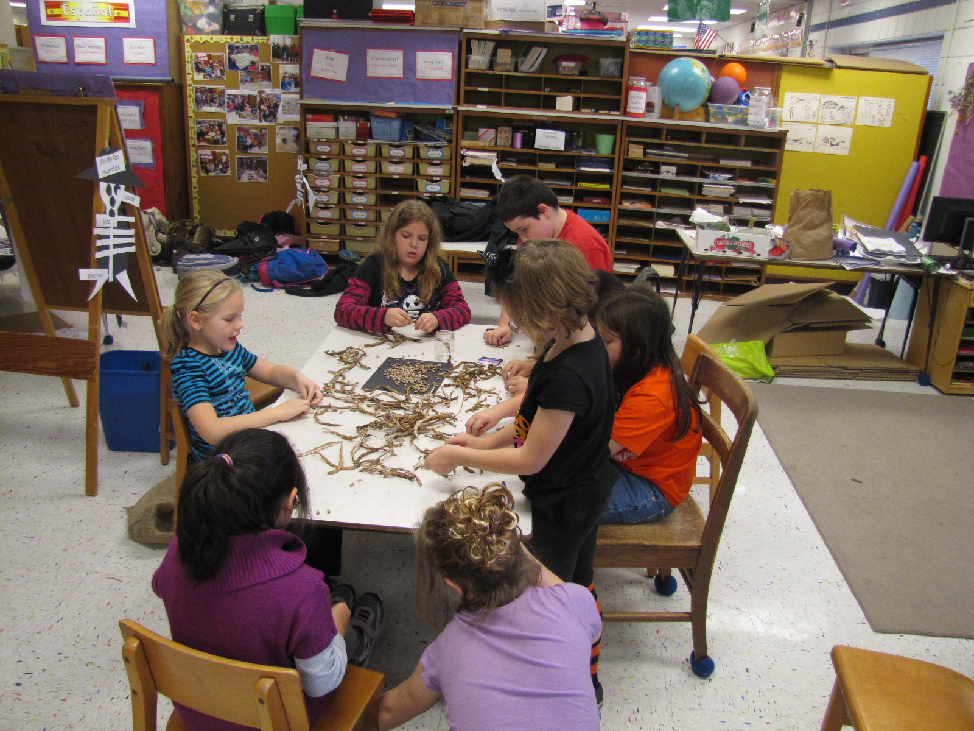
Saving Seeds

Slide 5
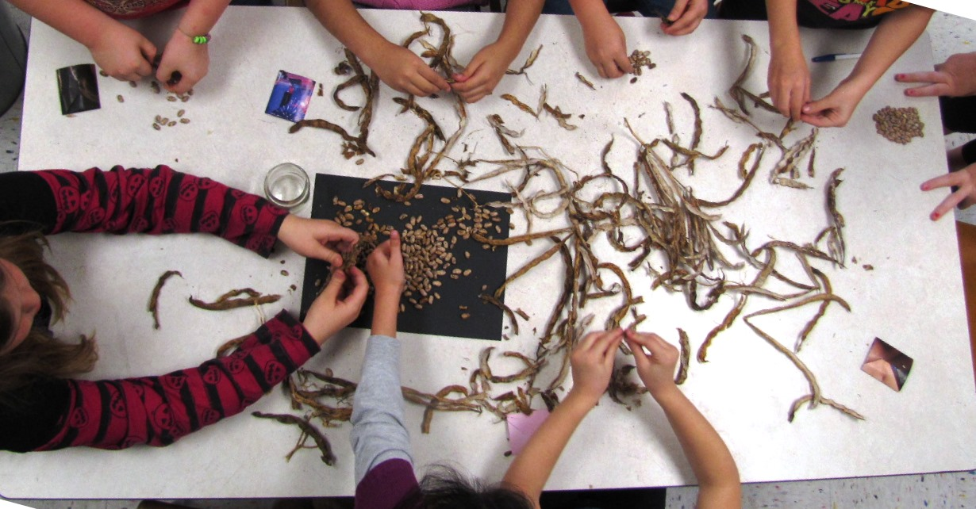
Rattlesnake beans

Slide 6
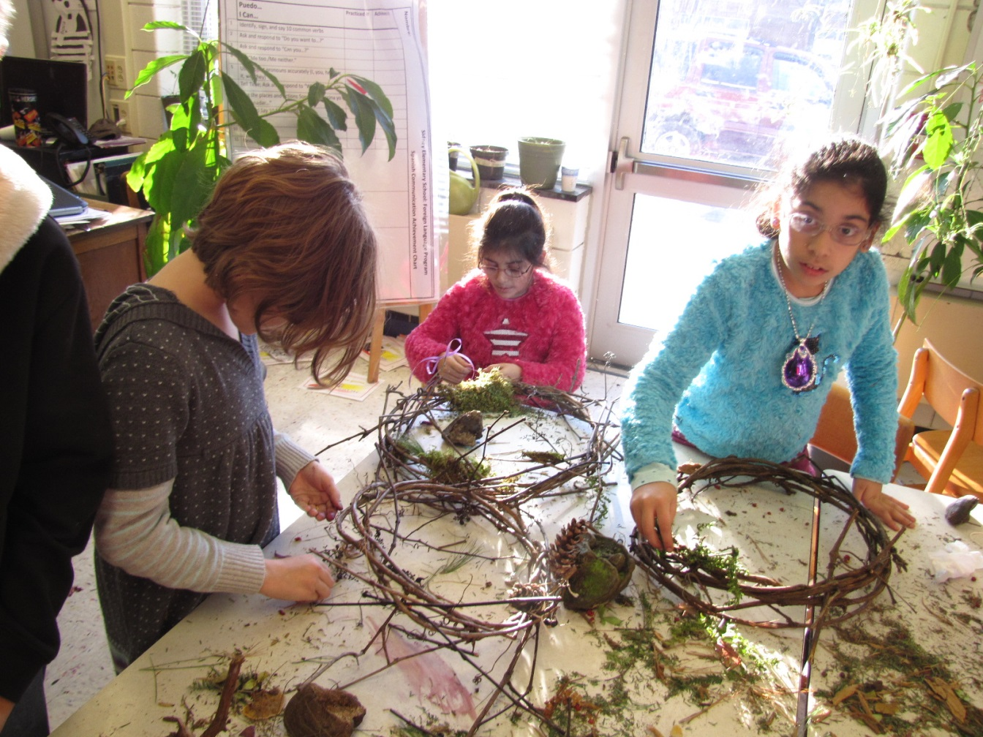
Horticulture Activities

Slide 7
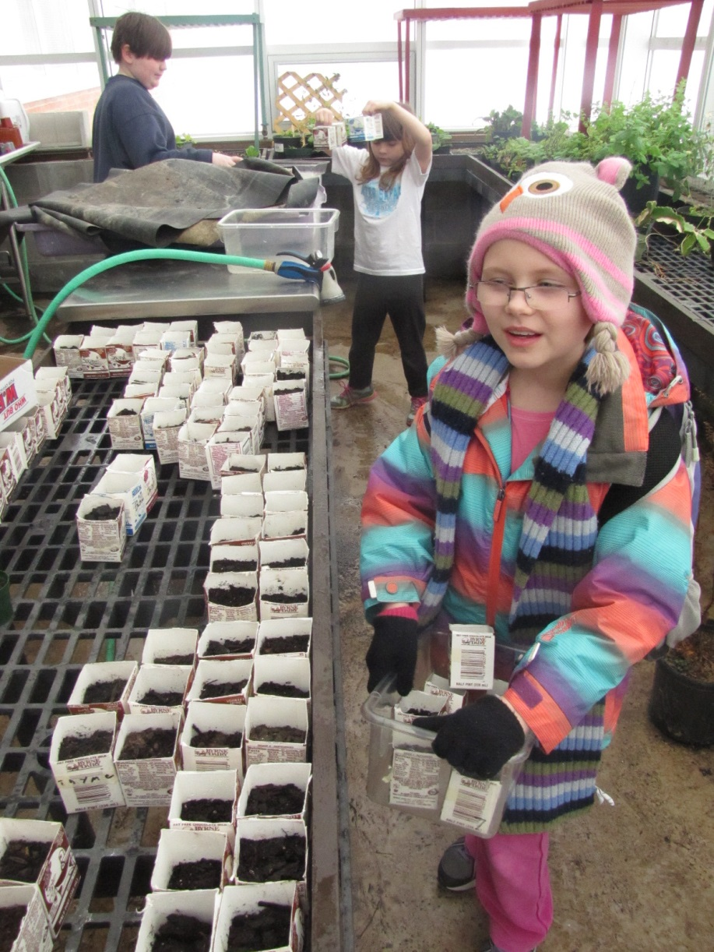
Working in the Greenhouse

Slide 8
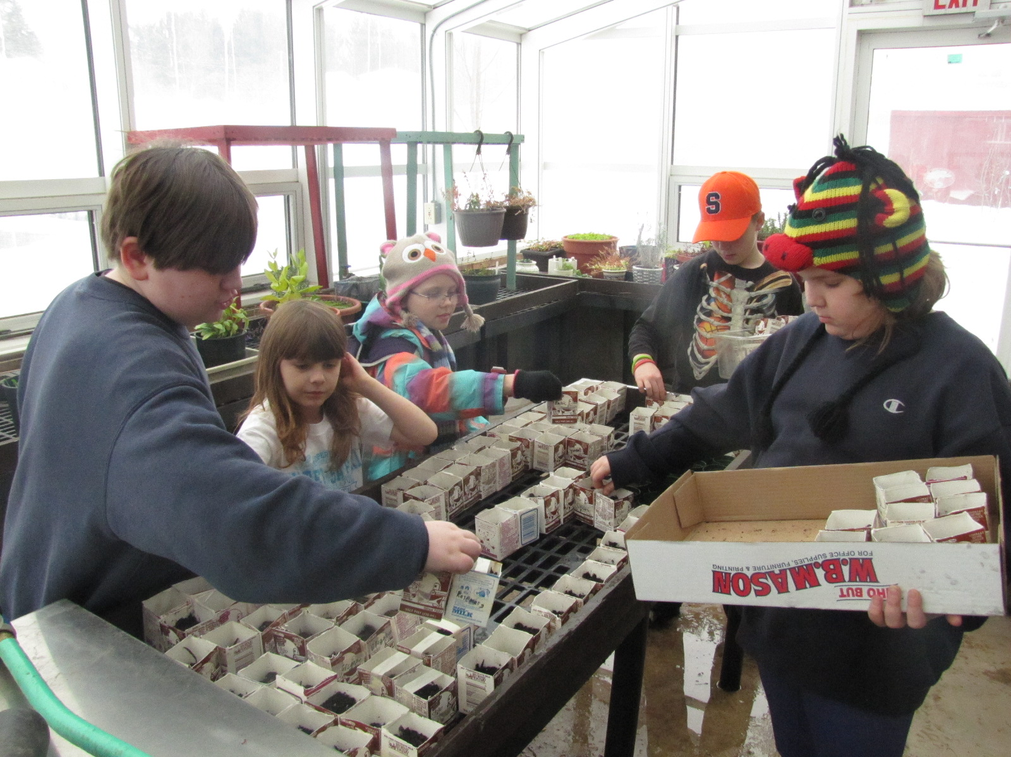

Slide 9
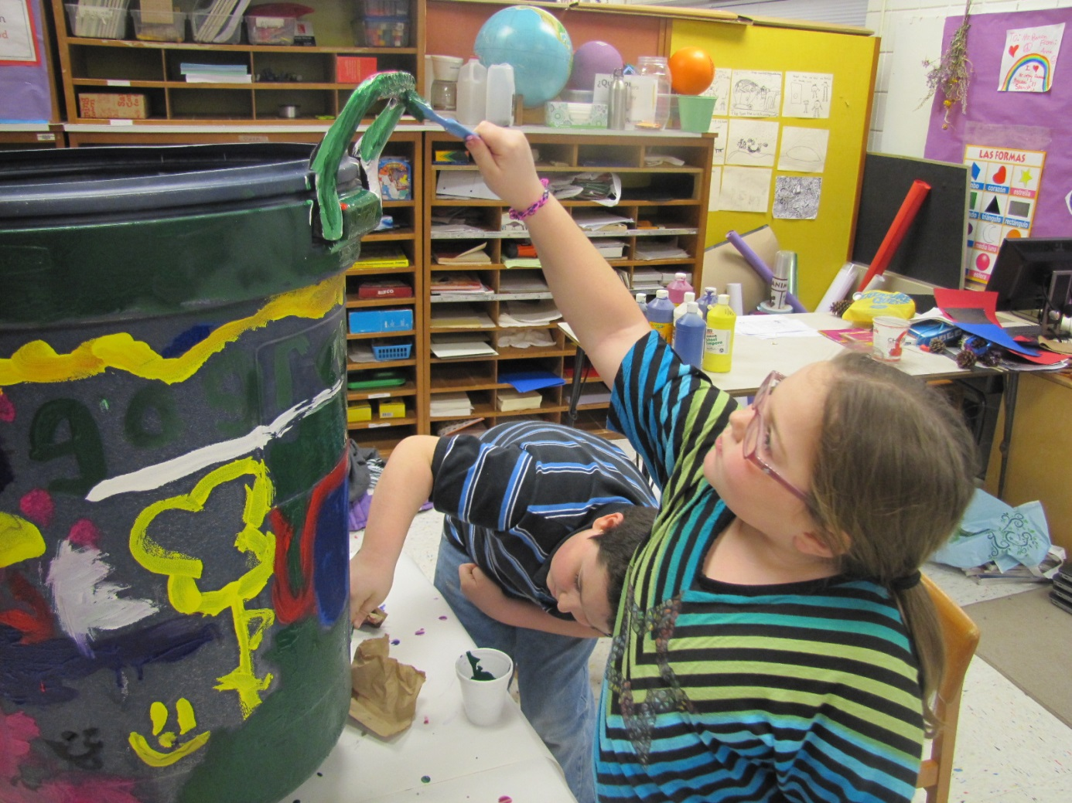
Composting

Slide 10
Community Involvement
What can we do together?
Would you like to volunteer in our group?
Can we work together on a project in Sidney?
Funding opportunities:
1.wheelchair accessible planters
2.worm composters

Slide 11
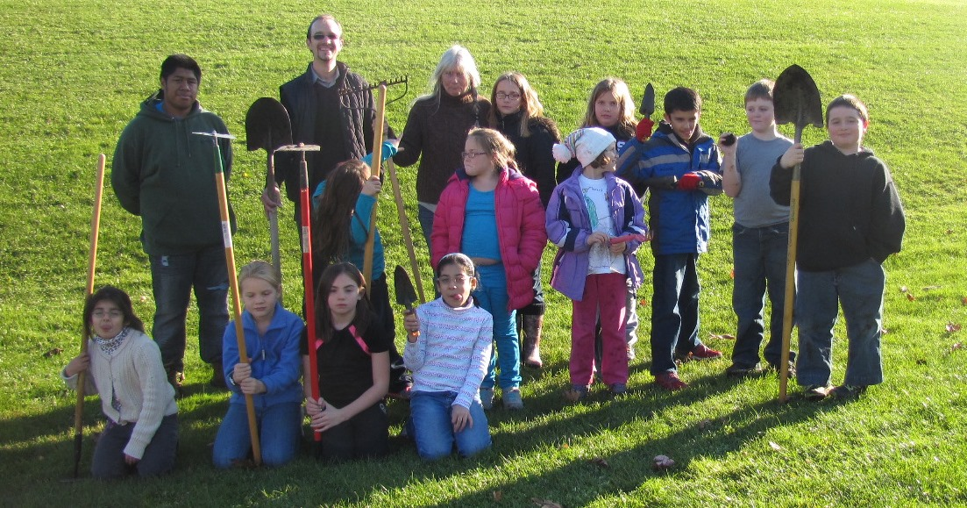
Questions?
Green Thumb Growers Guild

